Slide 1



Churn Prediction in the Banking Industry
Linda Hind SELAB

Slide 2
Table of Contents
Feature Selection
and
Preprocessing
Model Training
and
Evaluation
Introduction
Data Exploration
Conclusion
Notes:
"This project focuses on predicting customer churn in the banking industry using a dataset from kaggle with features such as demographics, account balances, and customer activity."

Slide 3
Context and Objective
What is a Churn Model?
A tool to predict customers who are likely to stop using a company's product or service.
Business Importance:
Retain high-value customers.
Lower acquisition costs for new customers.
Objective: Predict customer churn in banking using Kaggle data.
Notes:
"This project focuses on predicting customer churn in the banking industry using a dataset from kaggle with features such as demographics, account balances, and customer activity."
* A churn model is a predictive model used to identify customers who are likely to stop using a company product or services
----------------------------------
* the term churn refers to the loss of customer; for example: you used a bank service then you stopped using it and switch to another bank
---------------------------------
*Purpose of churn model:
* customer retention: companies identify customers at risk, and they take proactive measures to engage and retain those customers
*Target marketing: again we identify people how are potentially at risk and we give them special discounts; we treat them differently; we markt them with different campaigns; make sure they wont stop using our services.
it’s also used for resources allocation, for people potentially at risk; maybe allocate a special people in our call center; that communicate only we these costumers; making sure they get the best services; and dont leave
-------------------------------------
The objective is to classify customers as likely to churn or not using various machine learning models and evaluate their performance."

Slide 4
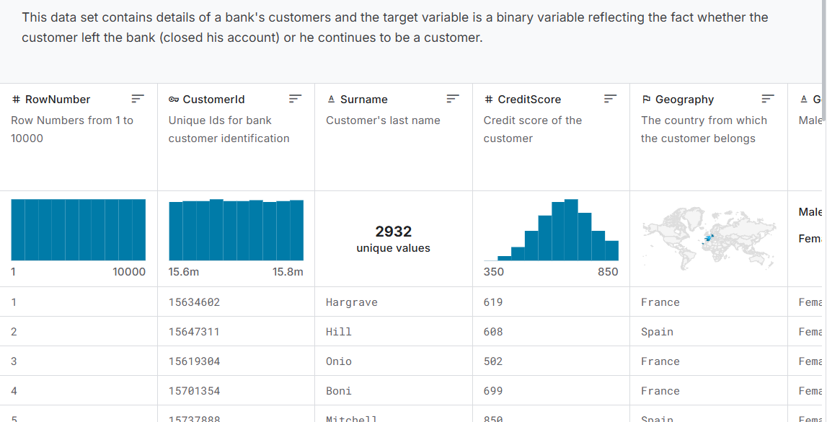
Source : Kaggle

Slide 5


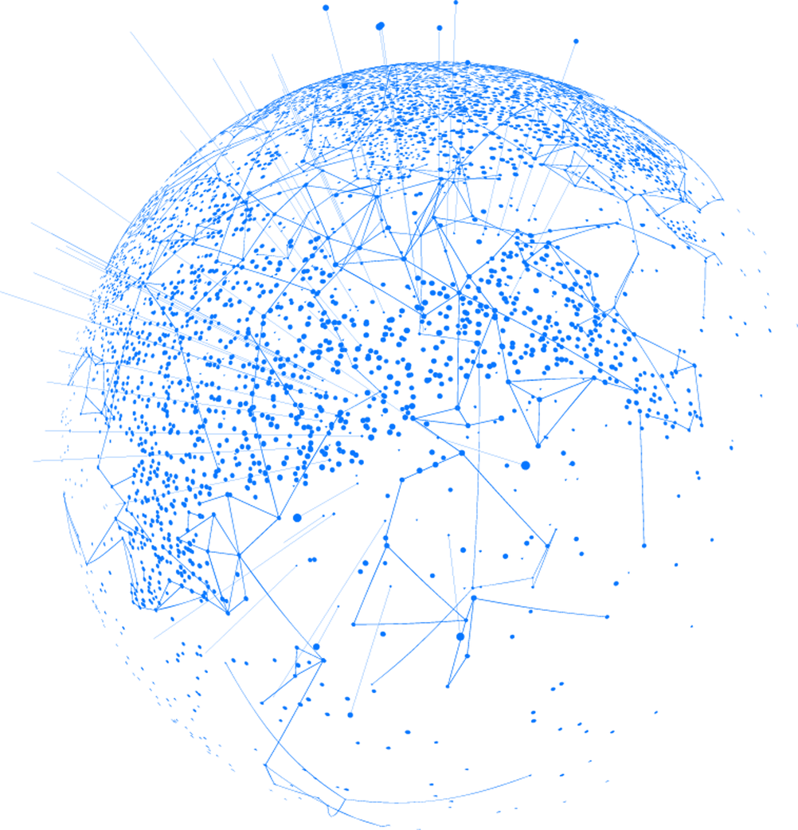
Workflow
Data Representation
Data Preparation
Data Exploration
Feature Engineering
Model Training
Evaluation
Notes:
The key steps include data exploration, model training, feature engineering, and evaluation.

Slide 6
Data Representation
Geography: Country of the customer (e.g., France, Spain).
Gender: Gender of the customer (e.g., Male, Female).
Age: Age of the customer.
Tenure: Number of years the customer has been with the bank.
Balance: Account balance of the customer.
NumOfProducts: Number of products the customer has purchased.
HasCrCard: Whether the customer has a credit card (1 = Yes, 0 = No).
IsActiveMember: Whether the customer is an active member (1 = Yes, 0 = No).
EstimatedSalary: Estimated annual salary of the customer.
Exited: Whether the customer left the bank (1 = Yes, 0 = No) — this is likely the target for churn prediction.

Slide 7
Data Preparation
Checking missing values
Checking Duplicated values
Drop unnecessary columns
'RowNumber', 'CustomerId', and 'Surname' are irrelevant for prediction
Encoding categorical variables : 'Gender', 'Geography',

Slide 8
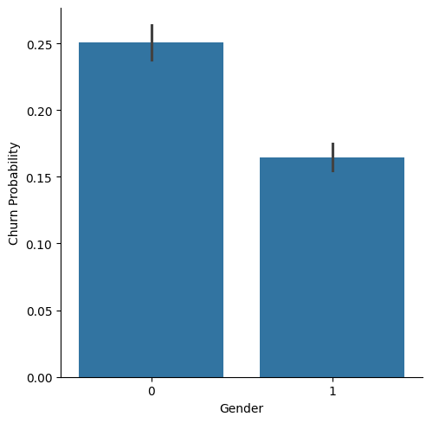
Data Exploration
Bar Chart Gender and Exited
Notes:
"Next, we analyzed the impact of gender on churn."
Plot Description:
"Female customers have a higher probability of churning compared to male customers. This insight highlights gender as a potentially important feature."

Slide 9
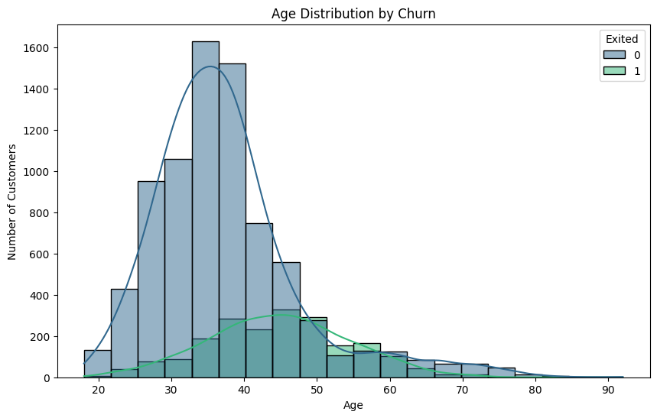
Data Exploration
Visualize the distribution of customer ages based on the target variable Exited.
Histogram of age and churn.
Notes:
"This histogram confirms the earlier observation that churners are concentrated in a specific age range, emphasizing the importance of Age as a predictive feature."

Slide 10
Data Exploration
Insights:
Gender: Female customers churn more.
Age: Churners cluster in middle age (30-50).

Slide 11
Data Preparation
Feature Selection
Split data into testing and training
Feature Scaling
Notes:
* Feature Selection
I didnt create any new features; for first; I kept them as they were
"We selected features such as CreditScore, Gender, and other key variables to train our models."
* Splitting Data
"The dataset was split into 80% training and 20% testing sets to evaluate the models on unseen data."
* Feature Scaling
"Since features like CreditScore and Balance have different scales, we applied standard scaling to normalize them."
"This ensures consistent feature magnitudes, improving model performance for algorithms like SVM and KNN."

Slide 12
Models used
Random Forest
Logistic Regression
Support Vector Classifier (SVC)
K-Nearest Neighbors (KNN)
Gradient Boosting
Notes:
I chose a variety of models to balance simplicity and performance across different learning paradigms."
--------------------------------
Random Forest:
"Random Forest was selected for its ability to handle non-linear relationships and provide insights into feature importance, making it both robust and explainable."
--------------------------------
Logistic Regression:
"We Used with Logistic Regression as a baseline model because it is simple, interpretable, and helps us understand the linear relationships in the data."
----------------------------
Support Vector Classifier (SVC):
We used SVC because it handles non-linear patterns well and balances precision and recall better than simpler models."
_______________________________
K-Nearest Neighbors (KNN):
"KNN was chosen to evaluate how a simple instance-based learning algorithm performs, leveraging proximity to similar data points for predictions.
"
"KNN was included as it’s straightforward and works well when relationships are based on similarity between data points."
_______________________________
Gradient Boosting:
"Gradient Boosting was chosen because it’s great at finding complex patterns and performed best in accuracy and recall."
_______________________________
"By combining these models, we aimed to compare their strengths and identify the one best suited for our dataset."

Slide 13
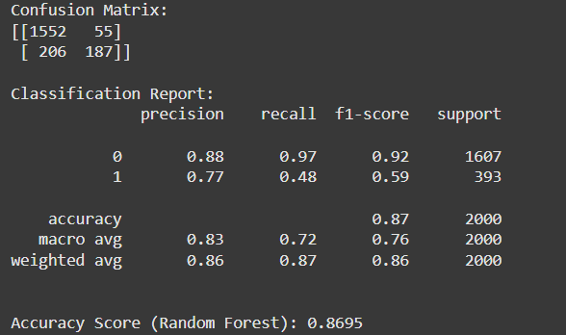
Random Forest
Notes:
Logistic Regression
"We started with Logistic Regression."
Results:
"It achieved an accuracy of 81.1%, but the recall for churners (class 1) was only 20%, indicating it struggled to identify churners."
Confusion Matrix Insights:
"The matrix showed a high number of false negatives for churners, highlighting its bias toward the majority class."
Support Vector Classifier (SVC)
"Next, we trained an SVC model."
Results:
"The SVC improved accuracy to 85.6% and recall for churners to 38%."
Confusion Matrix Insights:
"It reduced false negatives for churners compared to Logistic Regression, showing better balance between precision and recall."
K-Nearest Neighbors (KNN)
"The KNN model achieved an accuracy of 83%."
Results:
"Recall for churners was 37%, slightly better than Logistic Regression but worse than SVC."
Confusion Matrix Insights:
"KNN struggled with classifying churners accurately, producing many false negatives."
Gradient Boosting Classifier
"Gradient Boosting significantly improved performance."
Results:
"It achieved an accuracy of 86.75% and a recall of 49% for churners."
Confusion Matrix Insights:
"This model correctly predicted 192 churners, while still missing 201."
Random Forest Classifier
"Finally, Random Forest emerged as the best-performing model."
Results:
"It achieved an accuracy of 86.95% and recall of 48% for churners."

Slide 14
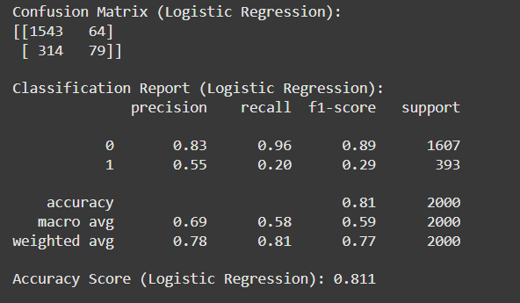
Logistic Regression
Notes:
Logistic Regression
"We started with Logistic Regression."
Results:
"It achieved an accuracy of 81.1%, but the recall for churners (class 1) was only 20%, indicating it struggled to identify churners."
Confusion Matrix Insights:
"The matrix showed a high number of false negatives for churners, highlighting its bias toward the majority class."
Support Vector Classifier (SVC)
"Next, we trained an SVC model."
Results:
"The SVC improved accuracy to 85.6% and recall for churners to 38%."
Confusion Matrix Insights:
"It reduced false negatives for churners compared to Logistic Regression, showing better balance between precision and recall."
K-Nearest Neighbors (KNN)
"The KNN model achieved an accuracy of 83%."
Results:
"Recall for churners was 37%, slightly better than Logistic Regression but worse than SVC."
Confusion Matrix Insights:
"KNN struggled with classifying churners accurately, producing many false negatives."
Gradient Boosting Classifier
"Gradient Boosting significantly improved performance."
Results:
"It achieved an accuracy of 86.75% and a recall of 49% for churners."
Confusion Matrix Insights:
"This model correctly predicted 192 churners, while still missing 201."
Random Forest Classifier
"Finally, Random Forest emerged as the best-performing model."
Results:
"It achieved an accuracy of 86.95% and recall of 48% for churners."

Slide 15
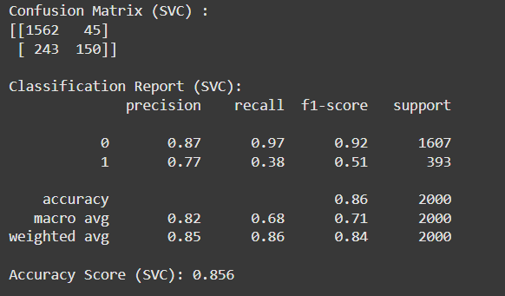
Support Vector Classifier (SVC)
Notes:
Logistic Regression
"We started with Logistic Regression."
Results:
"It achieved an accuracy of 81.1%, but the recall for churners (class 1) was only 20%, indicating it struggled to identify churners."
Confusion Matrix Insights:
"The matrix showed a high number of false negatives for churners, highlighting its bias toward the majority class."
Support Vector Classifier (SVC)
"Next, we trained an SVC model."
Results:
"The SVC improved accuracy to 85.6% and recall for churners to 38%."
Confusion Matrix Insights:
"It reduced false negatives for churners compared to Logistic Regression, showing better balance between precision and recall."
K-Nearest Neighbors (KNN)
"The KNN model achieved an accuracy of 83%."
Results:
"Recall for churners was 37%, slightly better than Logistic Regression but worse than SVC."
Confusion Matrix Insights:
"KNN struggled with classifying churners accurately, producing many false negatives."
Gradient Boosting Classifier
"Gradient Boosting significantly improved performance."
Results:
"It achieved an accuracy of 86.75% and a recall of 49% for churners."
Confusion Matrix Insights:
"This model correctly predicted 192 churners, while still missing 201."
Random Forest Classifier
"Finally, Random Forest emerged as the best-performing model."
Results:
"It achieved an accuracy of 86.95% and recall of 48% for churners."

Slide 16
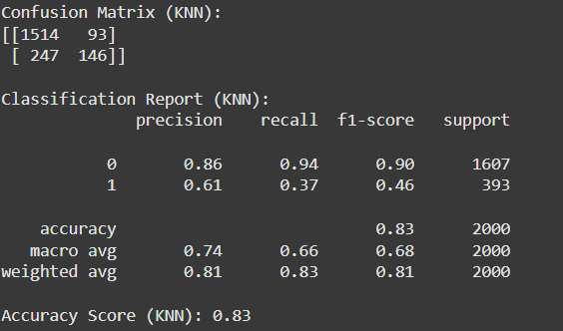
K-Nearest Neighbors (KNN)
Notes:
Logistic Regression
"We started with Logistic Regression."
Results:
"It achieved an accuracy of 81.1%, but the recall for churners (class 1) was only 20%, indicating it struggled to identify churners."
Confusion Matrix Insights:
"The matrix showed a high number of false negatives for churners, highlighting its bias toward the majority class."
Support Vector Classifier (SVC)
"Next, we trained an SVC model."
Results:
"The SVC improved accuracy to 85.6% and recall for churners to 38%."
Confusion Matrix Insights:
"It reduced false negatives for churners compared to Logistic Regression, showing better balance between precision and recall."
K-Nearest Neighbors (KNN)
"The KNN model achieved an accuracy of 83%."
Results:
"Recall for churners was 37%, slightly better than Logistic Regression but worse than SVC."
Confusion Matrix Insights:
"KNN struggled with classifying churners accurately, producing many false negatives."
Gradient Boosting Classifier
"Gradient Boosting significantly improved performance."
Results:
"It achieved an accuracy of 86.75% and a recall of 49% for churners."
Confusion Matrix Insights:
"This model correctly predicted 192 churners, while still missing 201."
Random Forest Classifier
"Finally, Random Forest emerged as the best-performing model."
Results:
"It achieved an accuracy of 86.95% and recall of 48% for churners."

Slide 17
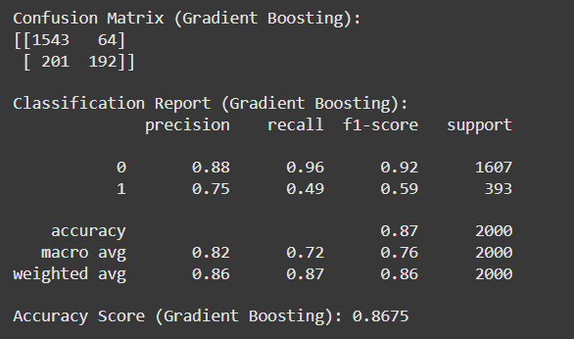
Gradient Boosting
Notes:
Logistic Regression
"We started with Logistic Regression."
Results:
"It achieved an accuracy of 81.1%, but the recall for churners (class 1) was only 20%, indicating it struggled to identify churners."
Confusion Matrix Insights:
"The matrix showed a high number of false negatives for churners, highlighting its bias toward the majority class."
Support Vector Classifier (SVC)
"Next, we trained an SVC model."
Results:
"The SVC improved accuracy to 85.6% and recall for churners to 38%."
Confusion Matrix Insights:
"It reduced false negatives for churners compared to Logistic Regression, showing better balance between precision and recall."
K-Nearest Neighbors (KNN)
"The KNN model achieved an accuracy of 83%."
Results:
"Recall for churners was 37%, slightly better than Logistic Regression but worse than SVC."
Confusion Matrix Insights:
"KNN struggled with classifying churners accurately, producing many false negatives."
Gradient Boosting Classifier
"Gradient Boosting significantly improved performance."
Results:
"It achieved an accuracy of 86.75% and a recall of 49% for churners."
Confusion Matrix Insights:
"This model correctly predicted 192 churners, while still missing 201."
Random Forest Classifier
"Finally, Random Forest emerged as the best-performing model."
Results:
"It achieved an accuracy of 86.95% and recall of 48% for churners."

Slide 18
Model Training and Results
Models Evaluated:
Logistic Regression: 81.1% accuracy, recall 20%.
SVC: 85.6% accuracy, recall 38%.
Gradient Boosting: 86.75% accuracy, recall 49%.
Random Forest: 86.95% accuracy, recall 48%.
Gradient Boosting and Random Forest performed best.
Notes:
Logistic Regression
"We started with Logistic Regression."
Results:
"It achieved an accuracy of 81.1%, but the recall for churners (class 1) was only 20%, indicating it struggled to identify churners."
Confusion Matrix Insights:
"The matrix showed a high number of false negatives for churners, highlighting its bias toward the majority class."
Support Vector Classifier (SVC)
"Next, we trained an SVC model."
Results:
"The SVC improved accuracy to 85.6% and recall for churners to 38%."
Confusion Matrix Insights:
"It reduced false negatives for churners compared to Logistic Regression, showing better balance between precision and recall."
K-Nearest Neighbors (KNN)
"The KNN model achieved an accuracy of 83%."
Results:
"Recall for churners was 37%, slightly better than Logistic Regression but worse than SVC."
Confusion Matrix Insights:
"KNN struggled with classifying churners accurately, producing many false negatives."
Gradient Boosting Classifier
"Gradient Boosting significantly improved performance."
Results:
"It achieved an accuracy of 86.75% and a recall of 49% for churners."
Confusion Matrix Insights:
"This model correctly predicted 192 churners, while still missing 201."
Random Forest Classifier
"Finally, Random Forest emerged as the best-performing model."
Results:
"It achieved an accuracy of 86.95% and recall of 48% for churners."

Slide 19
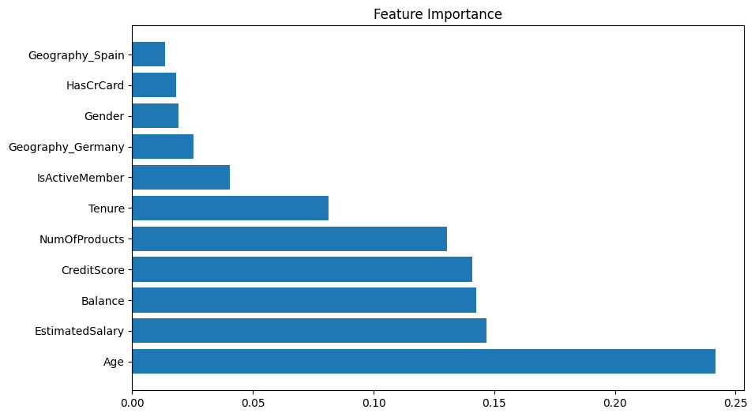
Feature Importance
Notes:
Feature Importance Insights:
"The feature importance plot revealed that Balance, Age,estimated salary were the top predictors."

Slide 20
Feature Engineering
New Features:
BalanceZero: Binary for zero balance.
Creates a binary column (BalanceZero) indicating whether the Balance is zero.
BalanceToSalaryRatio: Balance to Balance to Salary Ratio
Creates a new feature indicating the ratio of balance to estimated salary.
AgeGroup & TenureGroup: Categorical bins.
Groups tenure into intervals for improved feature engineering.
Interactions: Interaction between NumOfProducts and IsActiveMember
Interaction between NumOfProducts and IsActiveMember
Notes:
Feature Engineering
identify and create new features that can influence our model churn
"After training the initial models, we introduced feature engineering to enhance performance."
_______________________
New Features:
______________________
BalanceZero:
"A binary feature indicating whether a customer's balance is zero, which could correlate with churn behavior."
___________________________
BalanceToSalaryRatio:
"This feature normalizes a customer's balance against their estimated salary, providing insight into their financial behavior."
___________________________
AgeGroup and TenureGroup:
"We grouped continuous variables like Age and Tenure into categorical bins (e.g., 18-25 for age), making patterns easier for the models to learn."
______________________________
ProductUsage:
"This feature combines NumOfProducts and IsActiveMember to reflect how actively a customer uses the bank's products."
_____________________________
Interactions:
"We created interaction features like Male_Germany and Male_Spain to capture patterns based on gender and geography."
_________________________________
Impact:
"These features improved the model's ability to capture relationships in the data, as seen in the feature importance analysis from Random Forest."

Slide 21
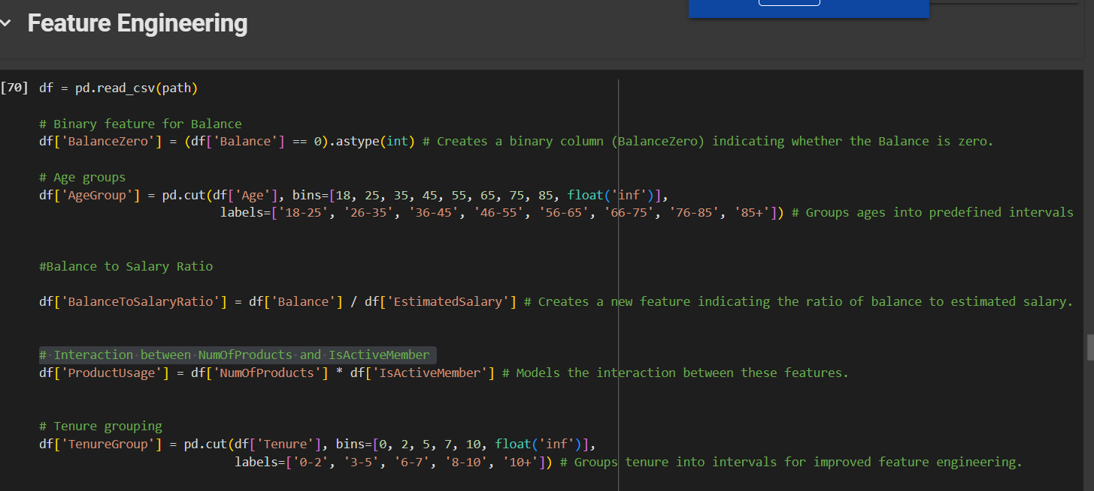
Feature Engineering
Improved model performance and interpretability.
Notes:
Feature Engineering
identify and create new features that can influence our model churn
"After training the initial models, we introduced feature engineering to enhance performance."
New Features:
BalanceZero:
"A binary feature indicating whether a customer's balance is zero, which could Feature Engineering
identify and create new features that can influence our model churn
"After training the initial models, we introduced feature engineering to enhance performance."
_______________________
New Features:
______________________
BalanceZero:
"A binary feature indicating whether a customer's balance is zero, which could correlate with churn behavior."
___________________________
BalanceToSalaryRatio:
"This feature normalizes a customer's balance against their estimated salary, providing insight into their financial behavior."
___________________________
AgeGroup and TenureGroup:
"We grouped continuous variables like Age and Tenure into categorical bins (e.g., 18-25 for age), making patterns easier for the models to learn."
______________________________
ProductUsage:
"This feature combines NumOfProducts and IsActiveMember to reflect how actively a customer uses the bank's products."
_____________________________
Interactions:
"We created interaction features like Male_Germany and Male_Spain to capture patterns based on gender and geography."
_________________________________
Impact:
"These features improved the model's ability to capture relationships in the data, as seen in the feature importance analysis from Random Forest."

Slide 22
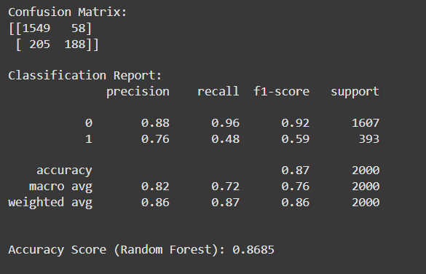
Feature Engineering
Improved model performance and interpretability.
Notes:
Feature engineering added value to the dataset, and worked in the sense that it helped improve the model's performance overall. The models with the engineered features achieved a reasonably high accuracy (~86-87%) and showed that these new features had an impact on the model's ability to predict customer churn.
------------------------
In summary, the feature engineering was successful in capturing more relevant patterns in the data, but improving the recall for the churn class (class 1) remains a key area of focus.

Slide 23
Conclusion
Summary:
Best models: Gradient Boosting and Random Forest (~87% accuracy)
Feature engineering enhanced predictive power.
Improved model performance and interpretability.
Notes:
"The best models, Gradient Boosting and Random Forest, achieved accuracies close to 87% but moderate recall for churners (~49%)."
---------------------------------
"Feature engineering played a key role in improving model performance."
-----------------------------------
In summary, the feature engineering was successful in capturing more relevant patterns in the data, but improving the recall for the churn class (class 1) remains a key area of focus.

Slide 24
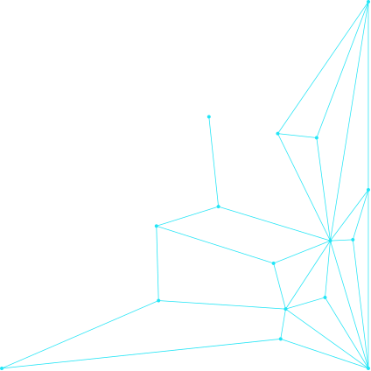
Thank you !

